Slide 1
CUA REU
WEEK 6
NUCLEAR PHYSICS
Richard Lara

Slide 2
Week Six’s Progress…
Overall: Got access to JLab ifarm and started working with the Monte Carlo Simulation of H(e,e’p) collisions
First used the data file of a H(e,e’p) scan with a angle of 0 radians to run the simulation
Use the simulated data root file to produce graphs of the kinematics:
Invariant Mass, Missing Energy, momentum components (x,y,z)
Didn’t have time to finish the analysis steps on the simulated data, however, I will provides the distribution of the these components extracted from the root file

Slide 3
Terms
Invariant Mass (Rest mass): Refers to the mass of a system of particles often called “invariant” because it’s constant regardless of the reference frame
Missing Energy: Refers to energy that is not directly detected in an experiment but is obtained from the Conservation of Energy Principle. (Provides important information about particles and interactions that are not directly observable)
Momentum Transfer: Amount of momentum exchanged between particles during a physics event
These quantities are important in reconstructing the kinematics of H(e,e’p) events
Conservation of Energy & Momentum in H(e,e’p) events

Slide 4
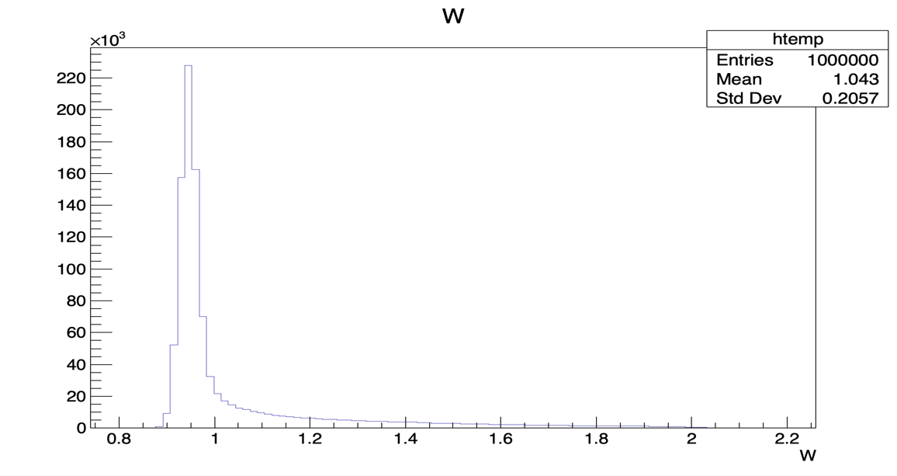
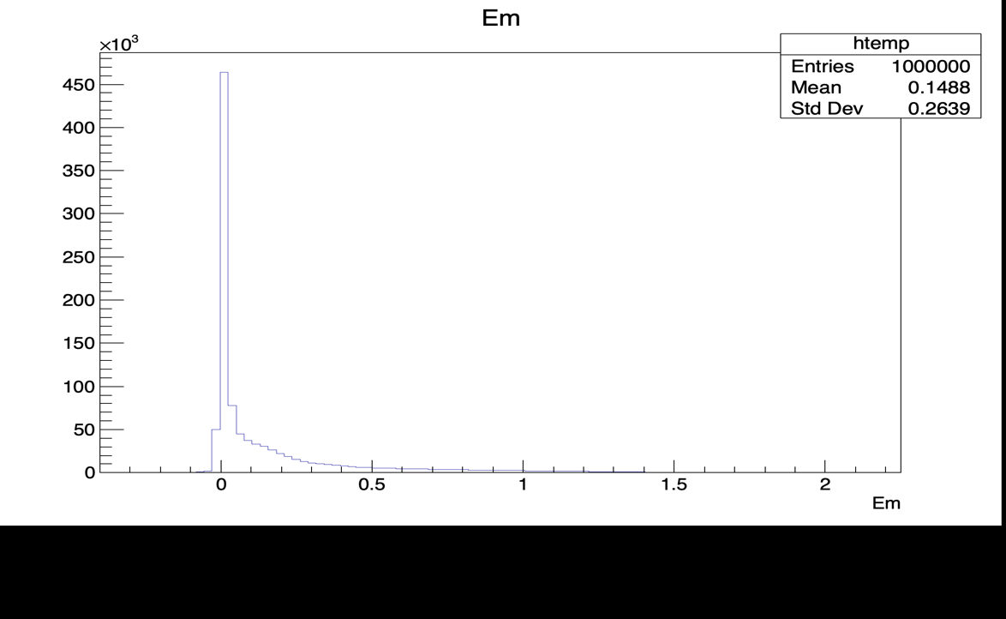
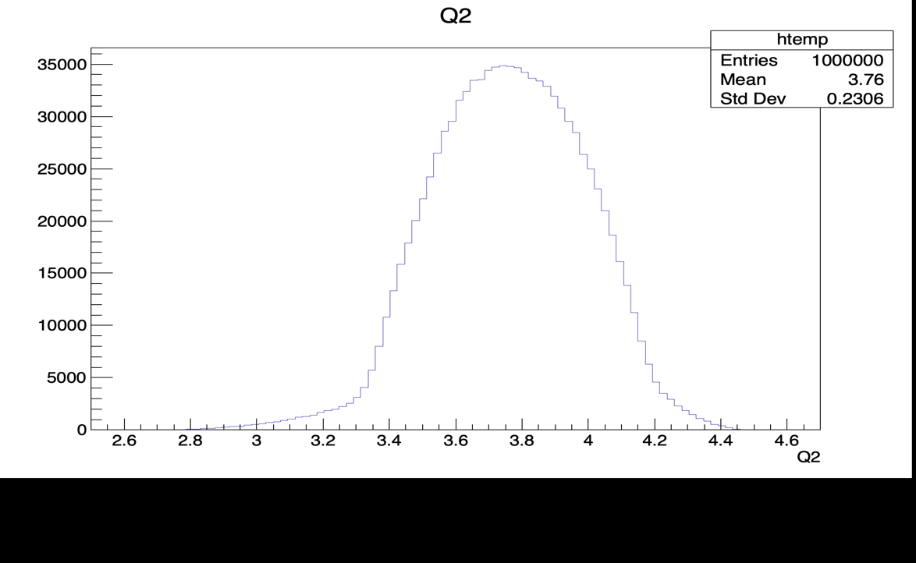
Missing energy
Invariant Mass
Momentum Transfer

Slide 5
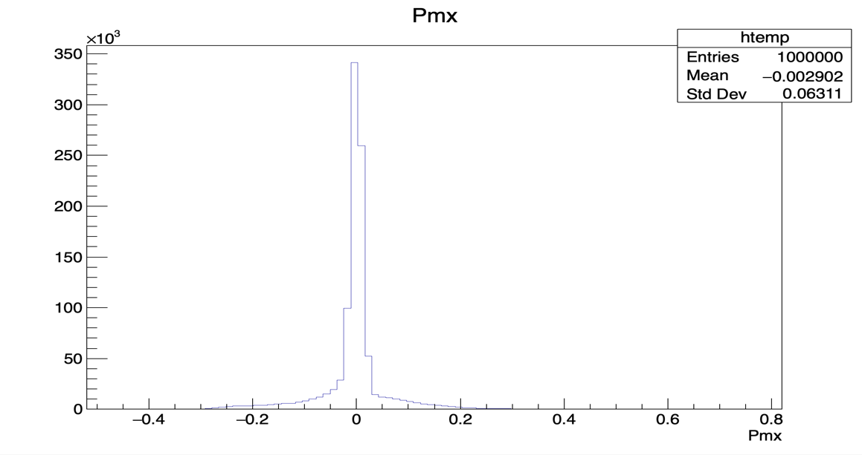

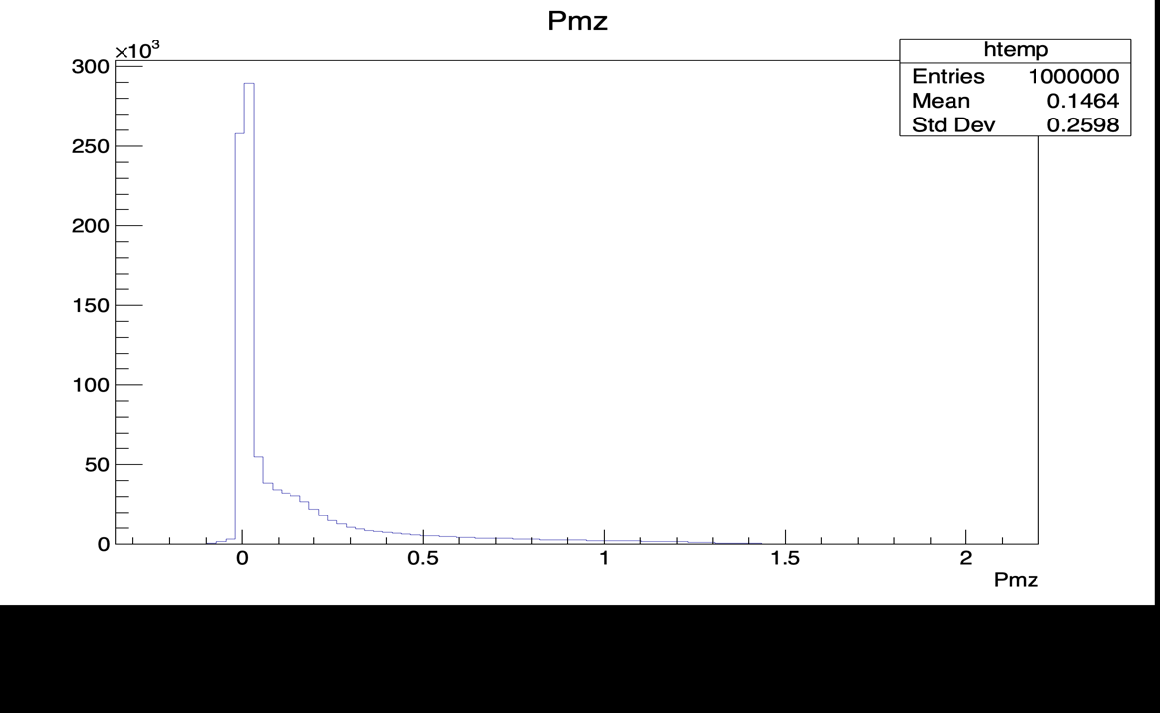

Slide 6
This Week
Finish the analysis steps of the simulated data → acquire the kinematic plots
Compare the simulation results to experimental results to check the precision and accuracy of calibration results
Understand the mathematical equations w.r.t. the kinematics of the H(e,e’p) event

